Slide 1
Pill Dispenser

Slide 2
What is Automated Pill Dispenser?
Pill dispenser is a device which will releases medication at specified time.
This project is basically de
This project is basically developed for the patients suffering fr. Automatic pill dispenser is a system that helps to dispense the right medication at the right time. It is the simplest way to manage the most complex medication regimes. Since older population and people suffering from chronic illness find it difficult to keep track of medications, and automatic pill dispenser helps them to adhere to timely medication. is considered a very efficient device of improving medication adherence.
s considered a very efficient device of improving medication adherence.

Slide 3
Motivation
The increasing old age population is one of the key factors driving the automatic pill dispenser. According to WHO, it is estimated that the world’s population aged 60 years and older are likely to double from 12% to 22% by 2050.
Unaffordability of a nurse or a helping hand.
While initially the product was designed with thinking the target audience as the main buyer of the product, it was later changed to make hospitals and retirement homes the main clients of the product
Unaffordability of a nurse or a helping hand.
Unaffordability of an help / nurse.
While initially the product was designed with thinking the target audience as the main buyer of the product, it was later changed to make hospitals and retirement homes the main clients of the product

Slide 4
OBJECTIVE
advancements in pill dispensers
Raising awareness regarding adherence to medications

Slide 5
Components
1.Arduino Uno R3 clone
2. Wires
3. Servo Motor
4. Serial LCD
5.Breadboard
6. Battery
7.RTC

Slide 6
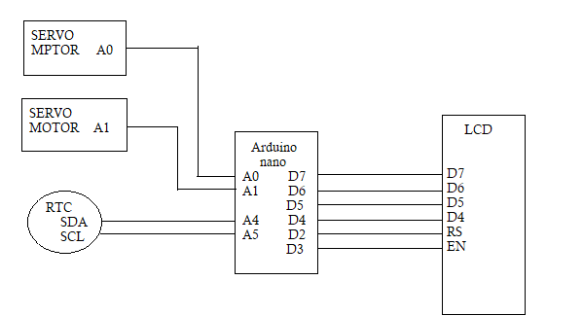
Block Diagram

Slide 7
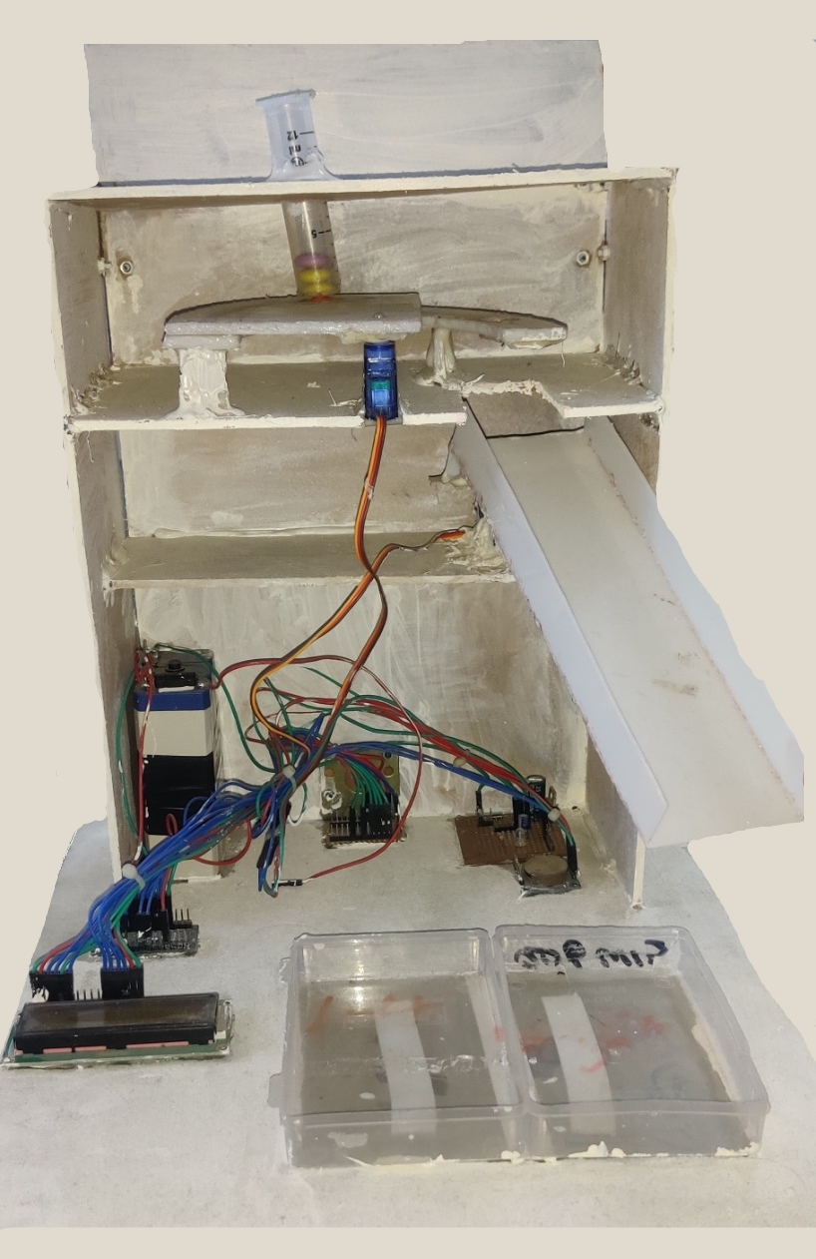
Model

